Slide 1

Team JAVA COURSE PROJECT Saba Tabassum - 2003A51100 Samreen -2003A51131 Under Guidance of T.SAMPATH KUMAR SIR
ENVIRONMENT PORTAL FOR BOTANIST & DOCTORS

Slide 2
CONCEPTS LEARNT FROM PROJECT
1. Files
2. Object Input/Output Streams
3. File Input/Output Streams
4. Exceptional Handling
5. File Appending
6. File Searching
7. Scanner I/O and Console I/O
8.Switch Case.
9. Java Swings5. Java GUI
10. Java Jcomponents

Slide 3
PROBLEMS FACED DURING PROJECT
1. File Searching
2. Java GUI data adding to file.

Slide 4
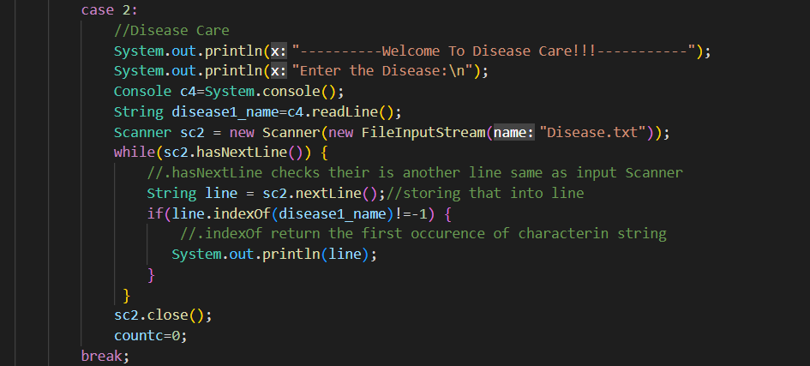
SOLUTIONS FOR PROBLEMS FACED
File Searching
Here Disease name is searched in a file disease.txt and return Disease name and pesticides

Slide 5
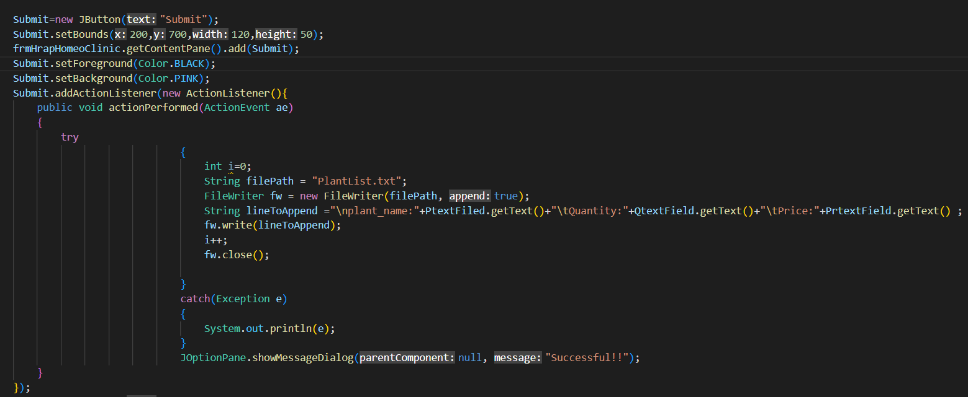
Java GUI data adding to file.

Slide 6
INTRODUCTION:
1. The Aim of this project is create a user friendly model help the botanist to analyse about plants store, plant healthcare ,and upcoming plant campaigns, with this it creates a automated and technologized model.
2. Plant Doctors :This project is like E -health management portal for doctors. Doctors need to keep prescription records of patients everytime , important information may be lost anytime.

Slide 7
OBJECTIVE
1. The main object of project is to create a user friendly ,automated ,technologized model to assist botanists and Doctors
2. Smart Green Environmental Portal For Botanists & Doctors.

Slide 8
SOLUTION:
1. In our proposed model, we categorize the users into two groups:
A. Nursery
B. Doctors
A. The botanist can access the Nursery option, can handle Nursery Management, Plant Health Care and Campaigns
B. Doctors can login to Doctor’s option , can handle List of Booked plant patient list, their health record and prescription.

Slide 9
WORKING MODEL:
Nursery
Nursery management
Plant Care
Campaigns
ADD
SELL
Discount
ADD DISEASE
DISEASE CARE
BOOK A DOCTOR
Doctor
Patients List
Health History
Prescription

Slide 10
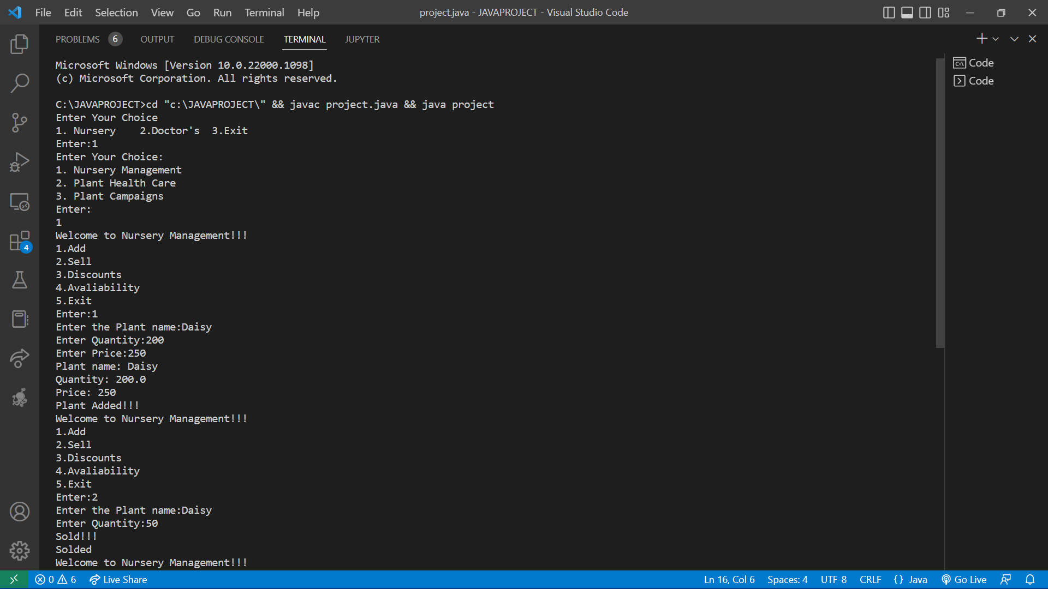
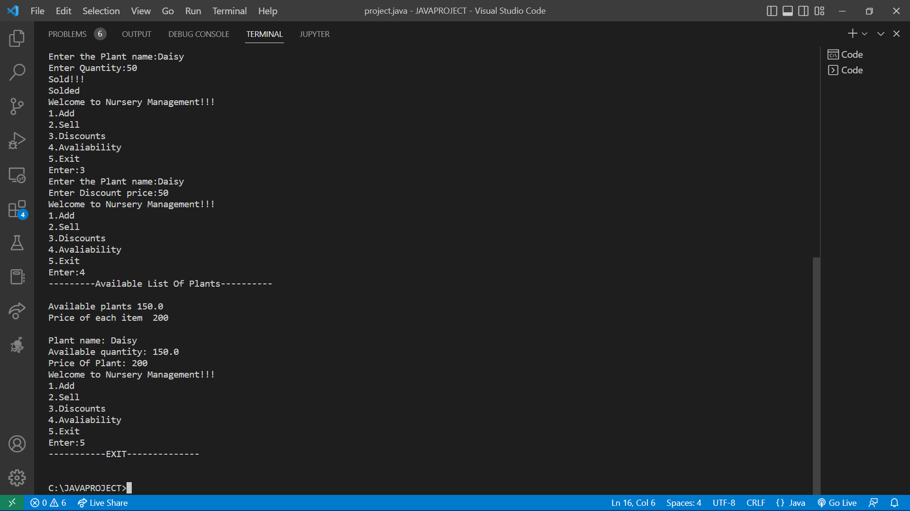
JUSTIFICATIONS 1. Nursery –Nursery Management

Slide 11
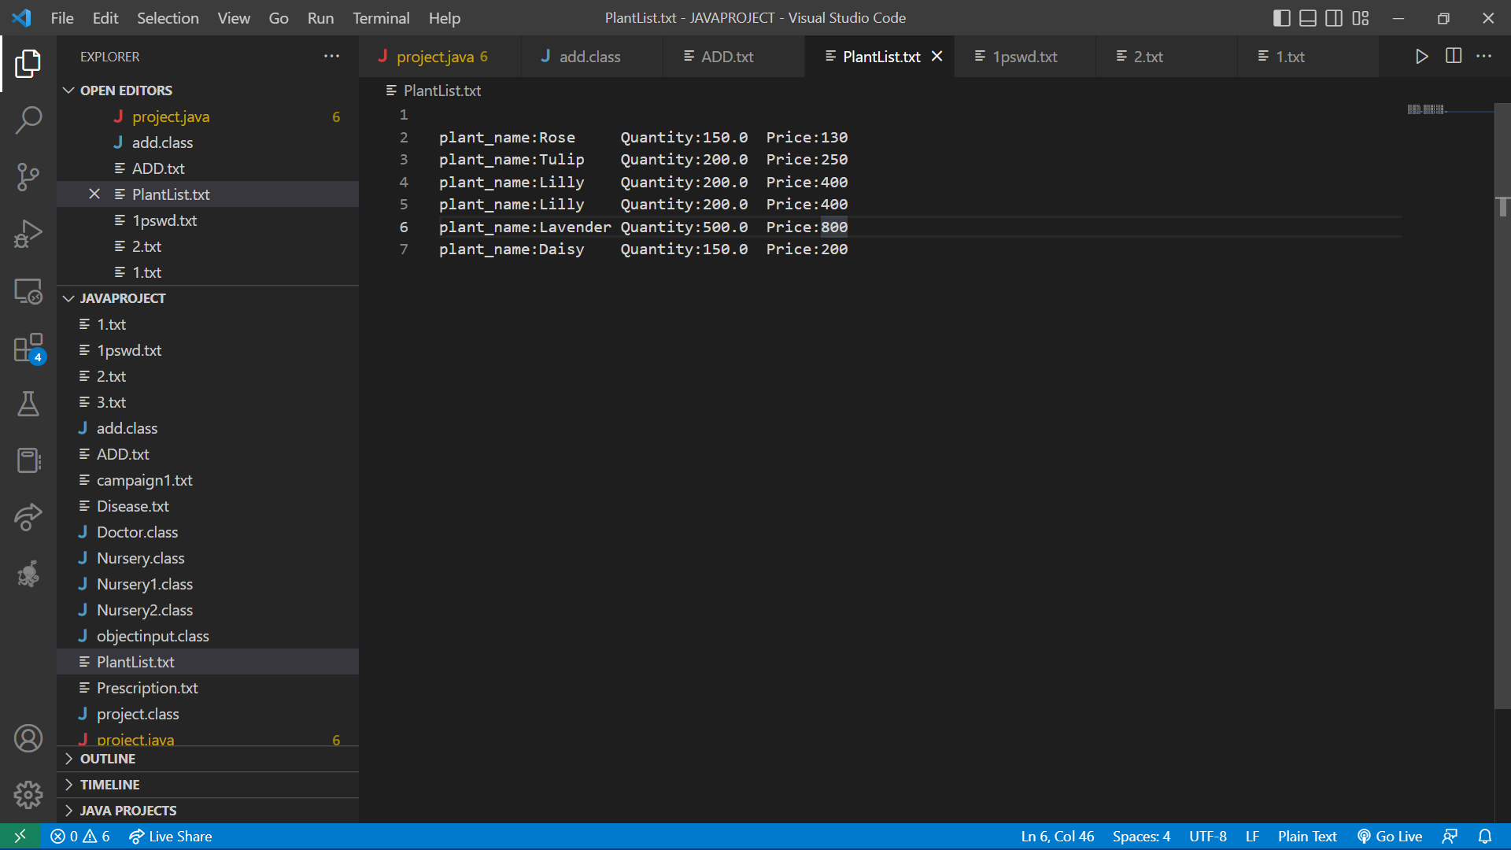
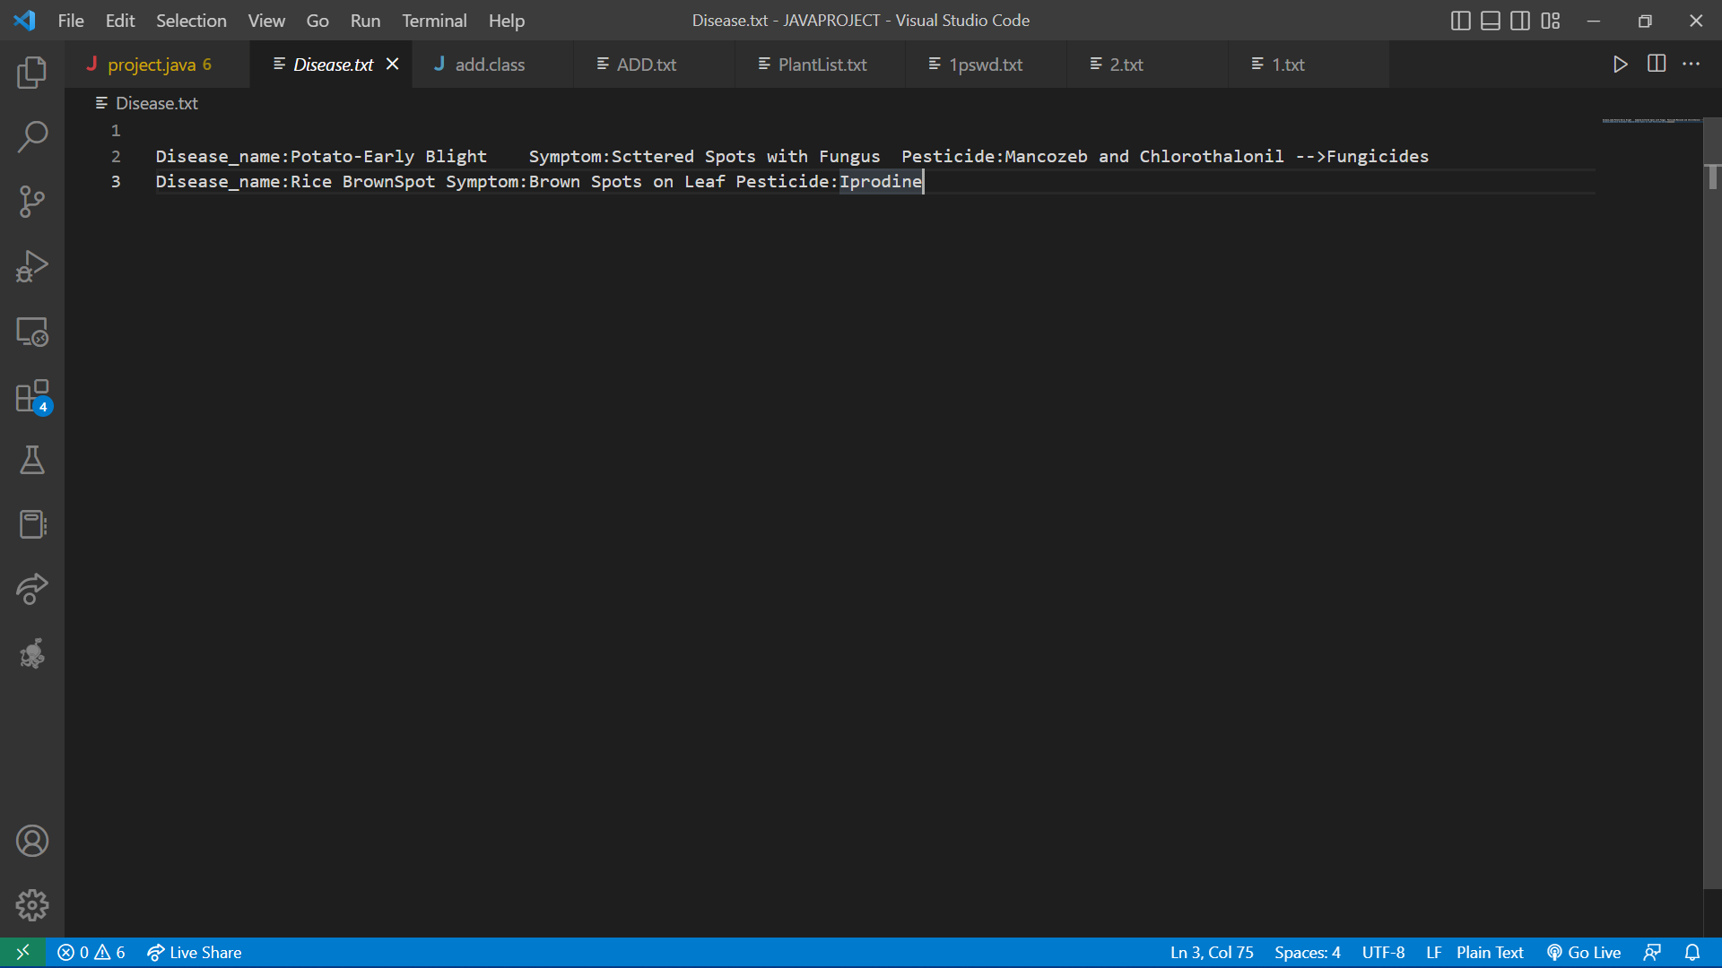
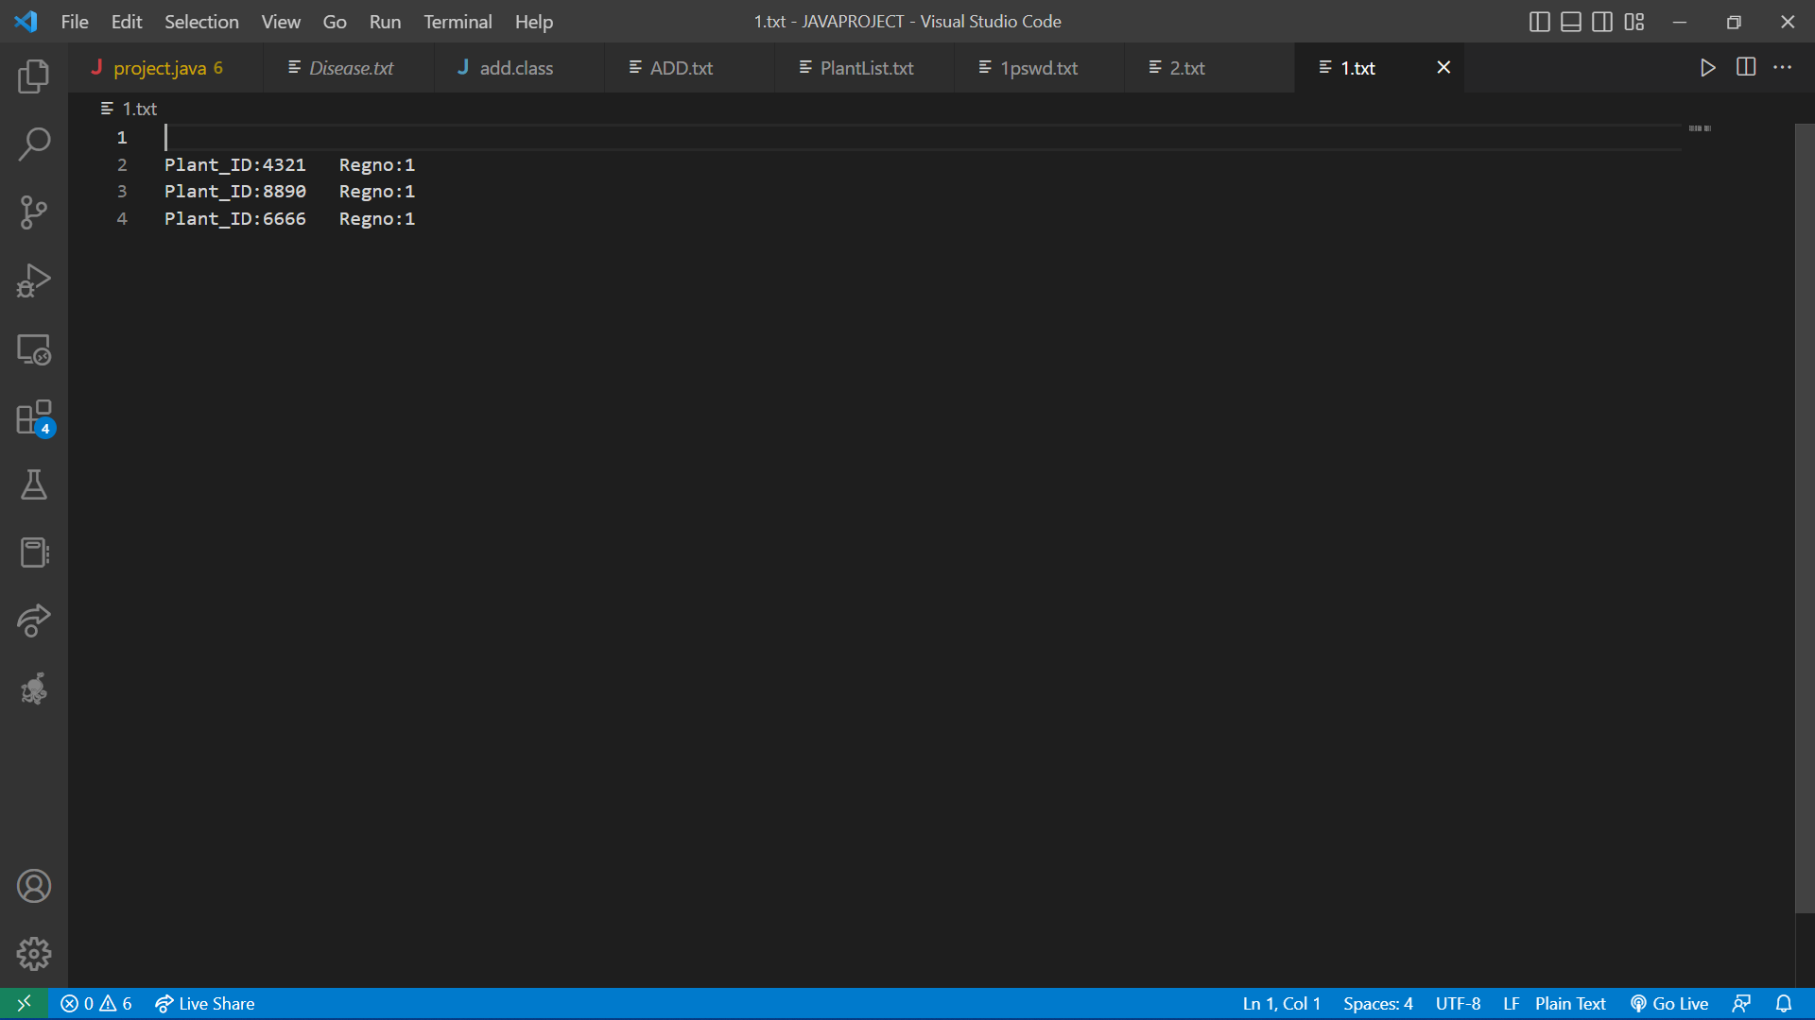
File After Appending: List of Plants
File After Appending: List of Disease, List of Booking

Slide 12
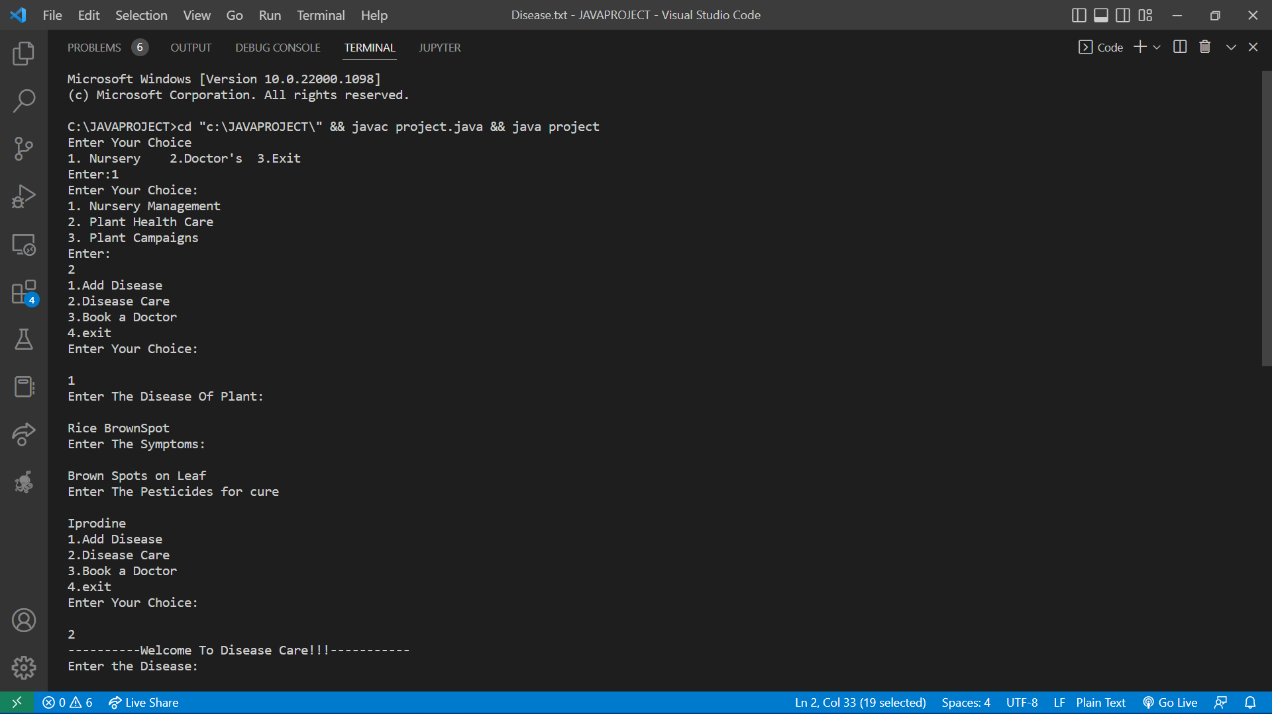
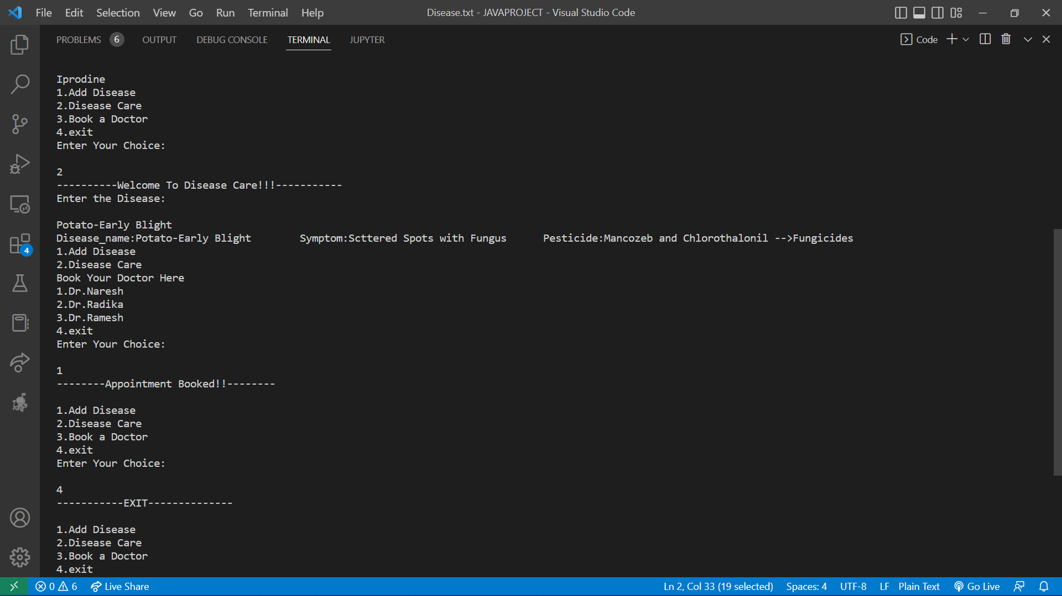
Plant Care:

Slide 13
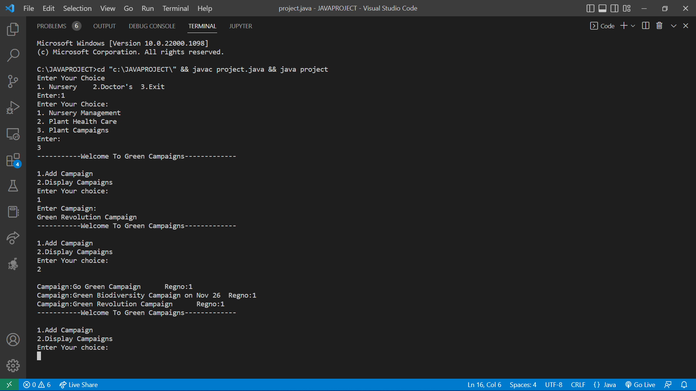
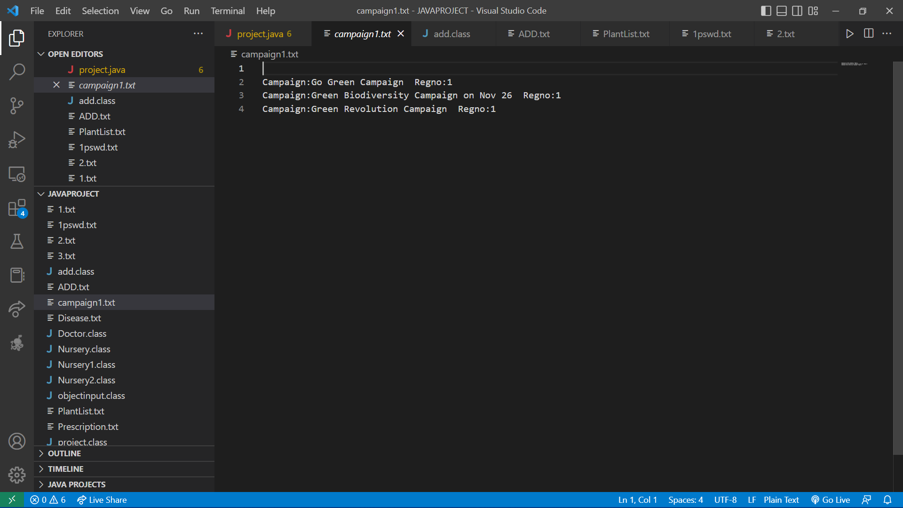
Campaign

Slide 14
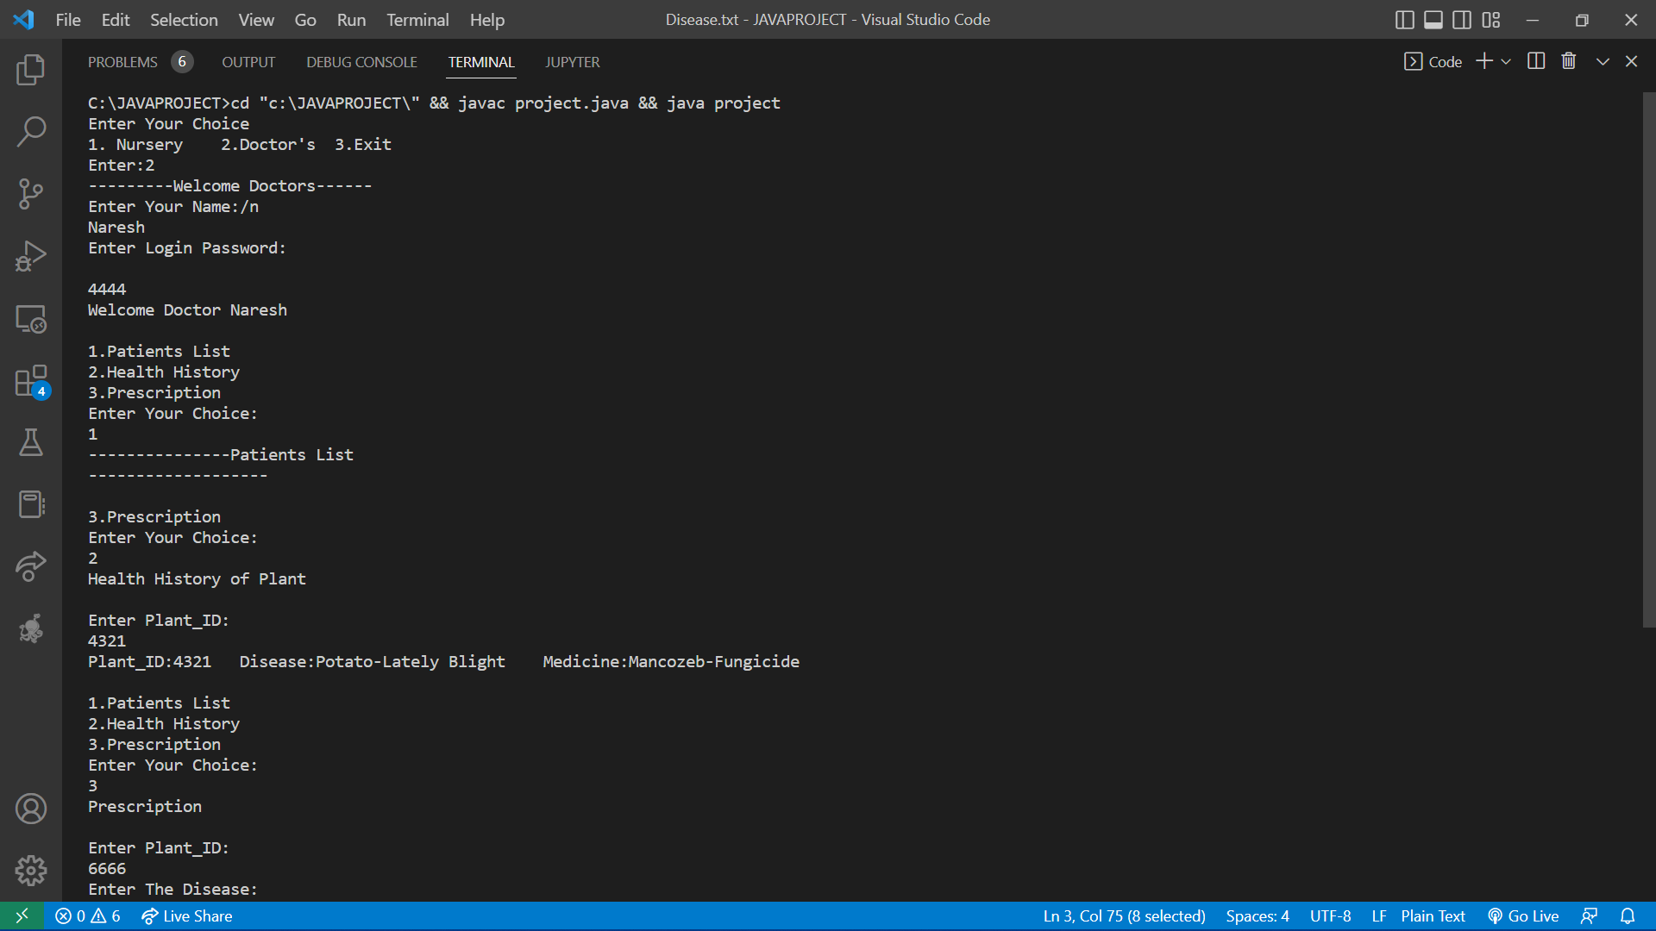
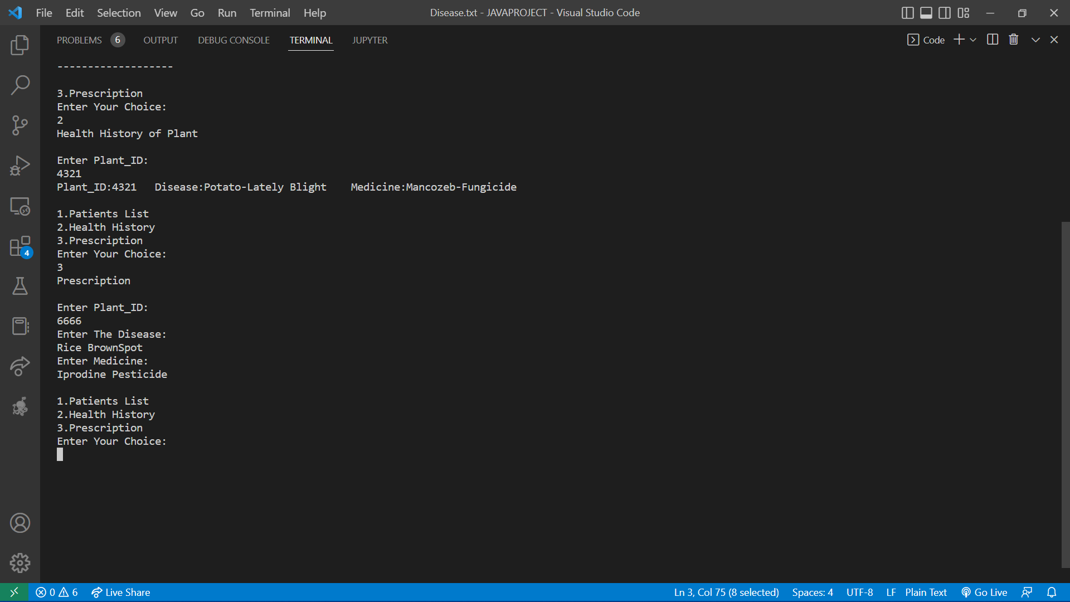
DOCTOR Patient’s List

Slide 15
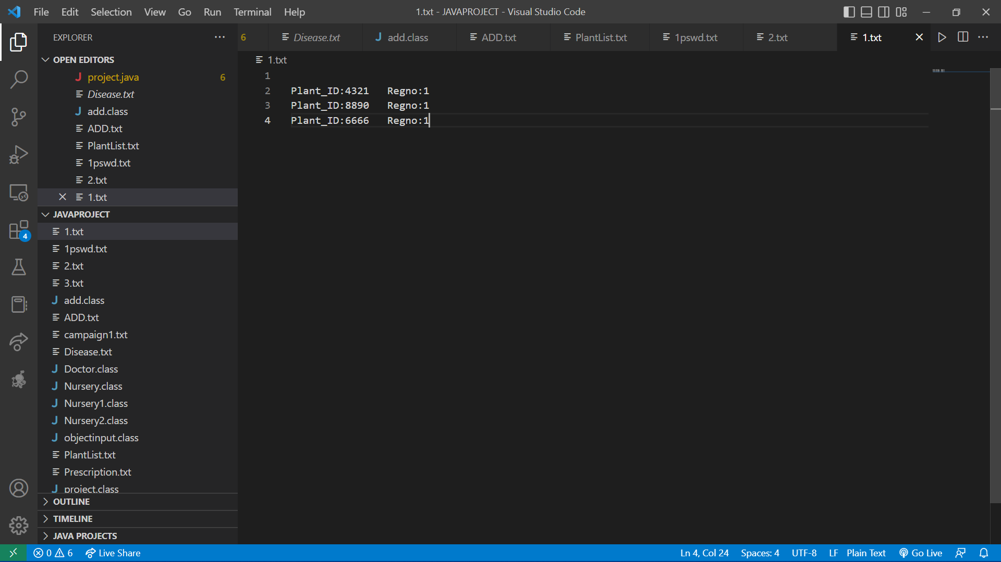
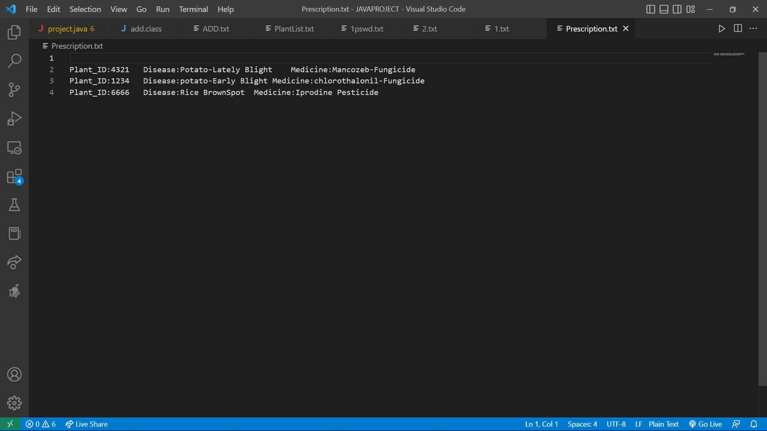
List Of Patients after Appending
List Of Prescription after Appending

Slide 16
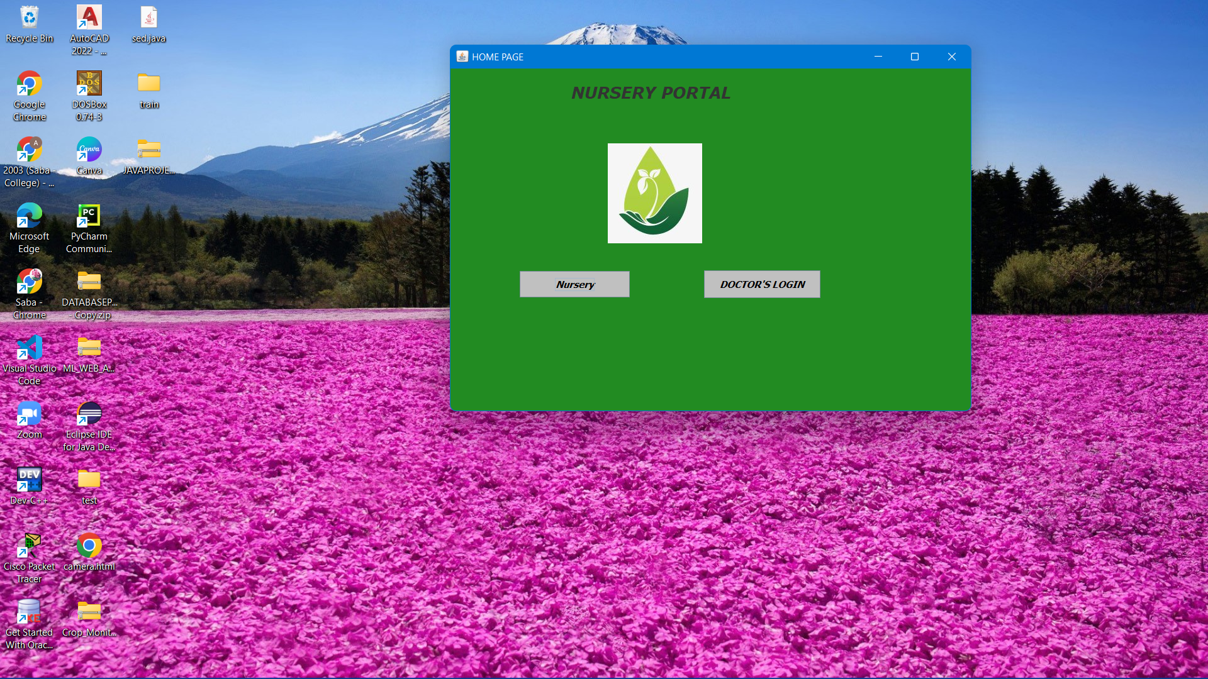
Using GUI

Slide 17
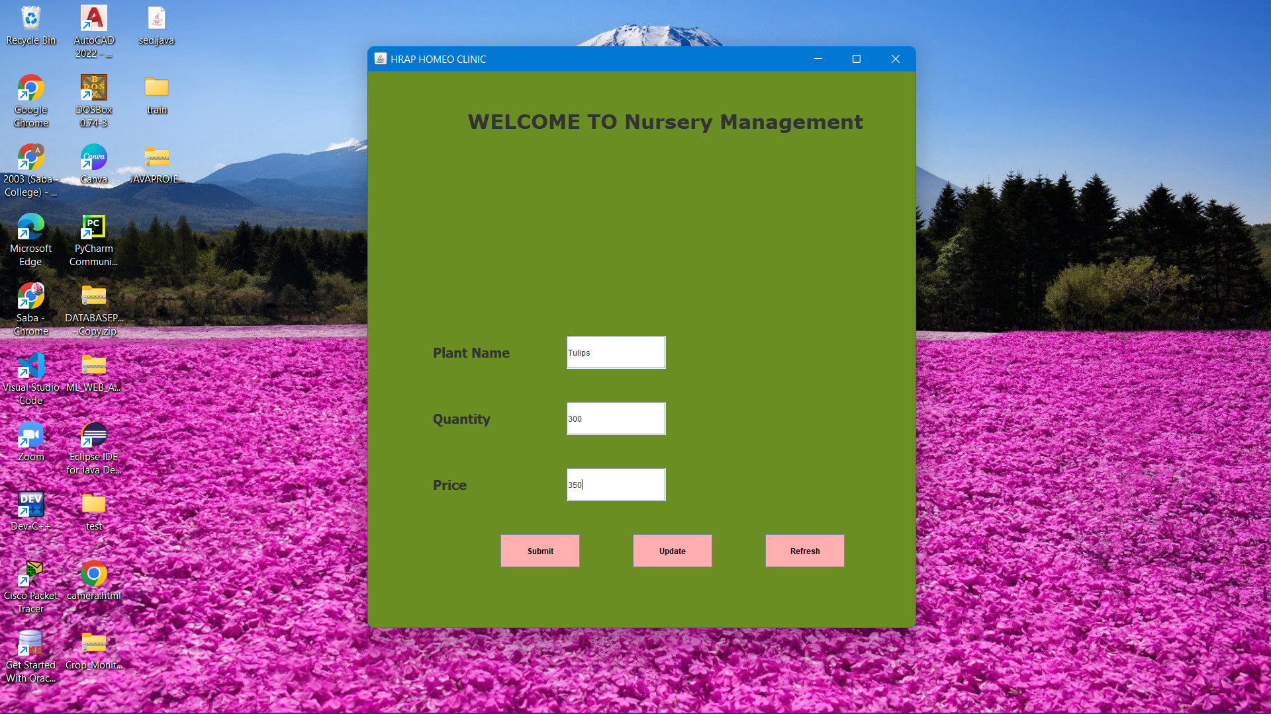
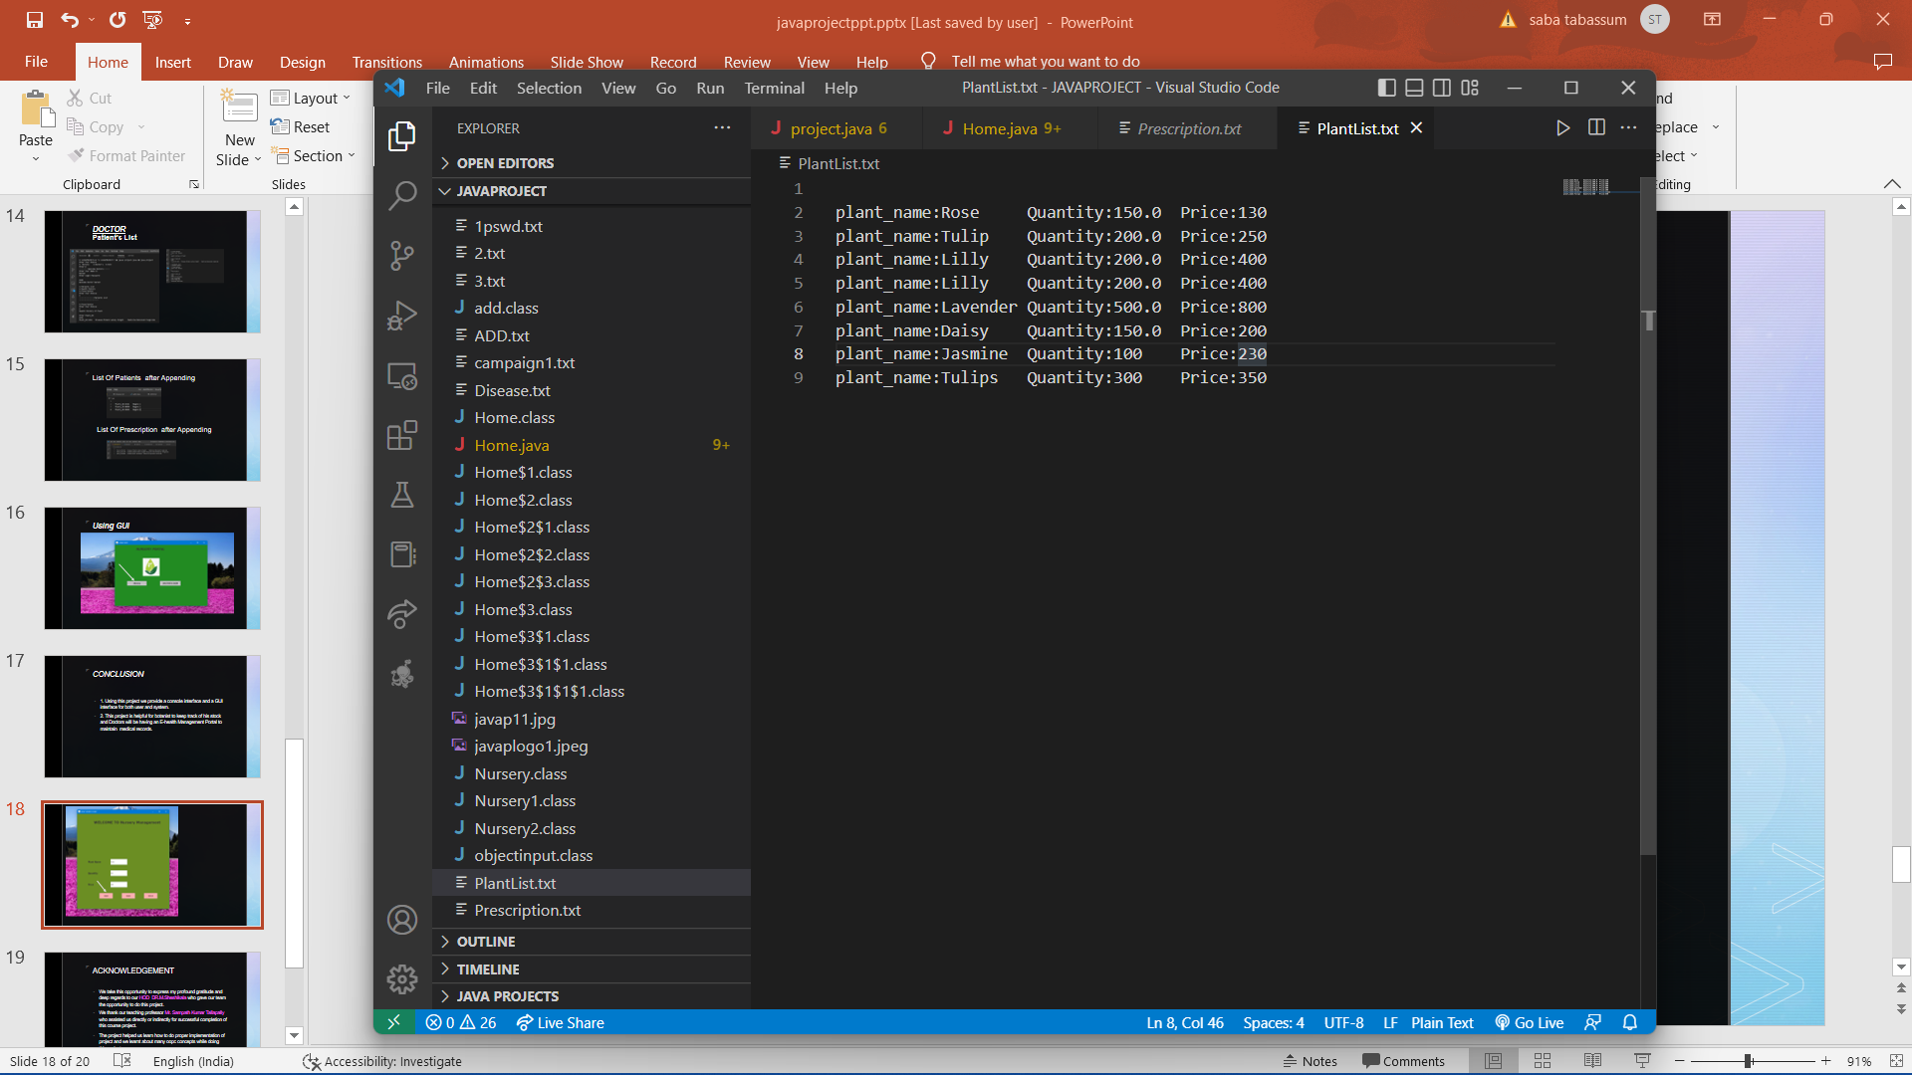
Stores in file PlantList.txt

Slide 18
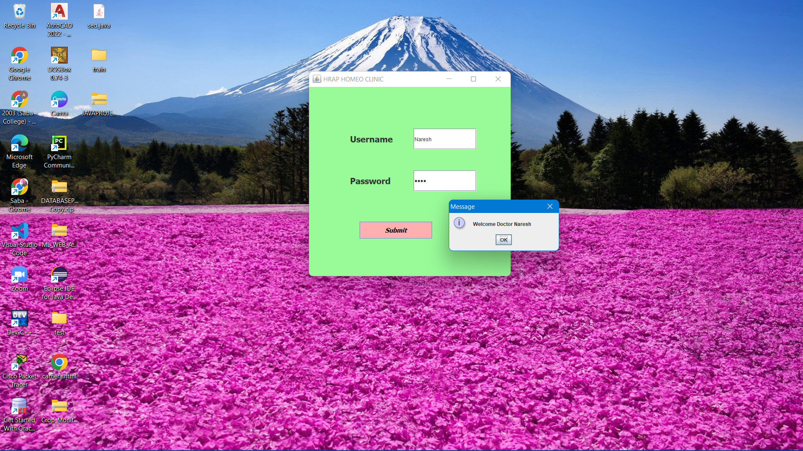
Doctors Login

Slide 19
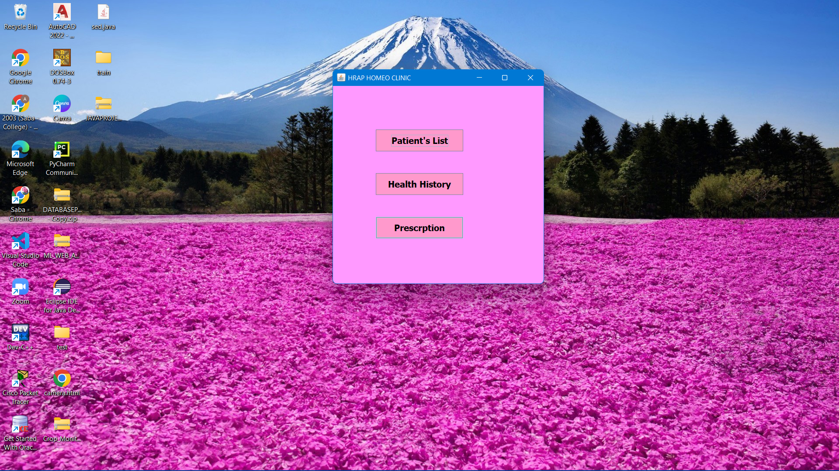
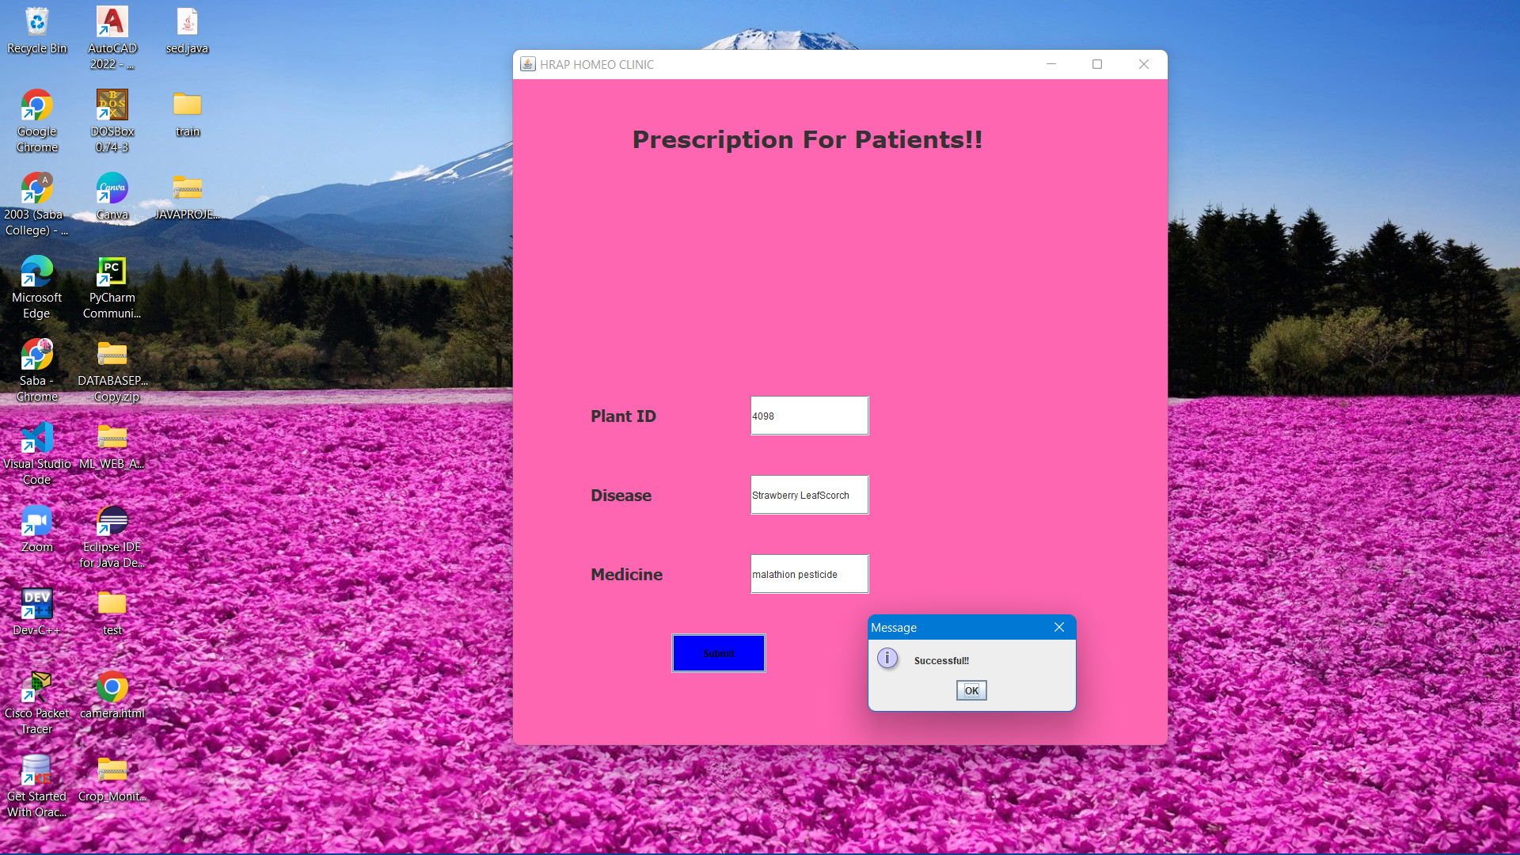
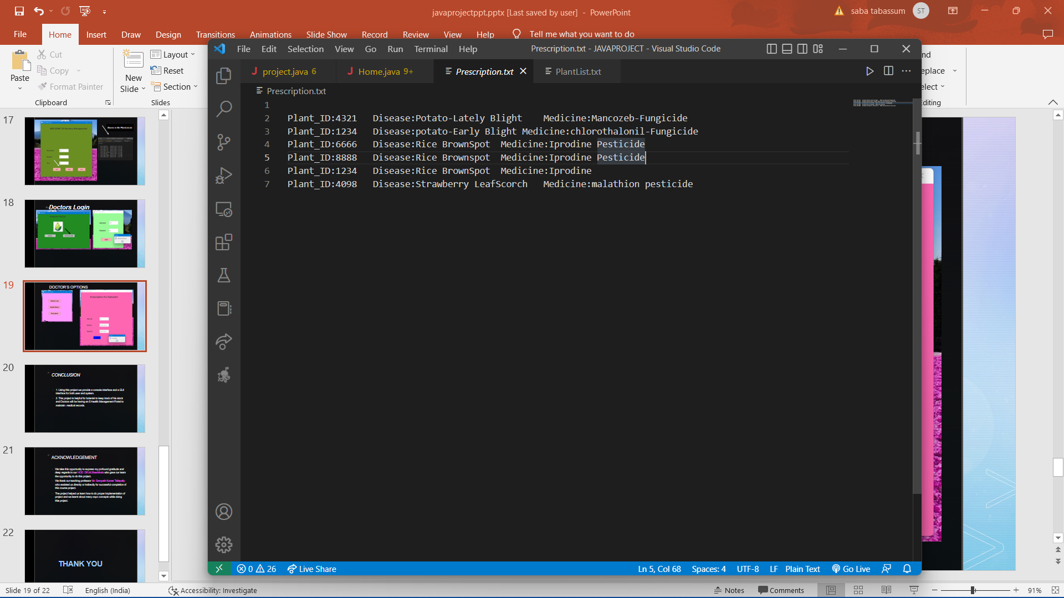
DOCTOR’S OPTIONS

Slide 20
REFERENCES
https://www.youtube.com/watch?v=CQMpXGwHeYQ
https://www.youtube.com/watch?v=Qb5PEmE0eEg
https://www.digitalocean.com/community/tutorials/java-append-to-file

Slide 21
CONCLUSION
1. Using this project we provide a console interface and a GUI interface for both user and system.
2. This project is helpful for botanist to keep track of his stock and Doctors will be having an E-health Management Portal to maintain medical records.

Slide 22
ACKNOWLEDGEMENT
We take this opportunity to express my profound gratitude and deep regards to our HOD DR.M.Sheshikala who gave our team the opportunity to do this project.
We thank our teaching professor Mr. Sampath Kumar Tallapally who assisted us directly or indirectly for successful completion of this course project.
The project helped us learn how to do proper implementation of project and we learnt about many oopc concepts while doing this project.

Slide 23
THANK YOU

